Slide 1
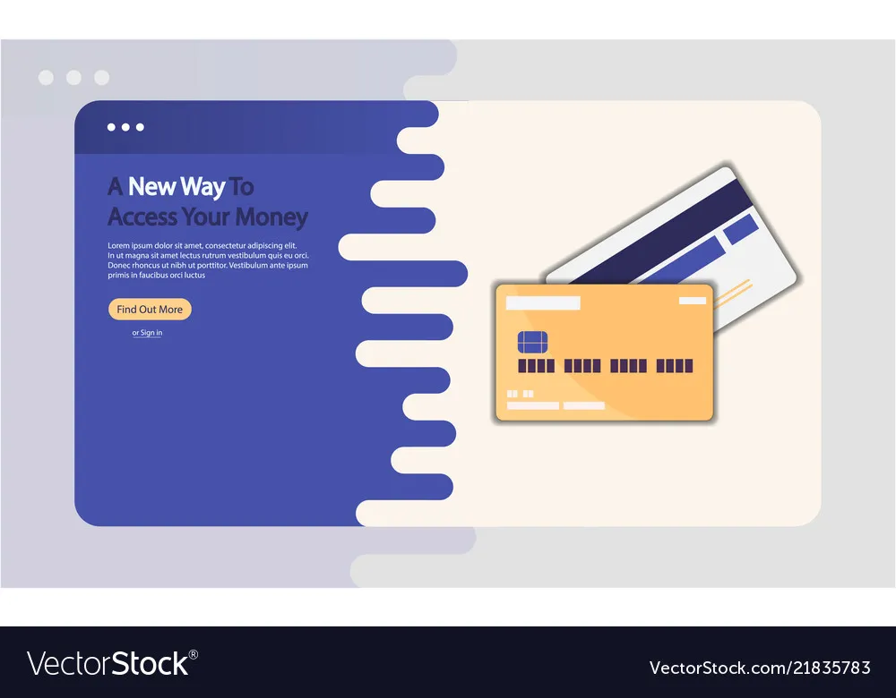

Slide 3


E-PAY
Nội dung
10.000 VNĐ

Slide 4


E-PAY
Paying with E-Wallet is much easier and more convenient now
Pay for the development and stability of functions day by day
10.000 VNĐ / month

